Slide 1
Cloud Native Enterprise
May 2016

Slide 2
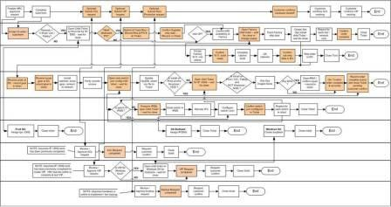
Traditional IT
Add DNS Entry
3 days
Provision VM
10 days
Deploy App
1 day
Install App Runtime
10 days
Configure Load Balancer
3 days
Scale Cluster
5 days
Configure SSL Termination
2 days
Configure Firewall
2 days
Update Runtime
45 days
Patch OS
10 days
Notes:
Scale, add capacity
Update, patch OS, application runtimes (worse case app server, etc)

Slide 3


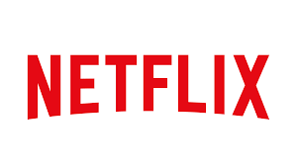

What makes these companies special?
Notes:
Amazon
Code push to prod every 11.6 seconds
Netflix
No downtime even with AWS services going down in 2015
Netflix deploy its Simian Army, software that deliberately attempts to wreak havoc on its systems.
Simian Army attacks Netflix infrastructure on many fronts
- Chaos Monkey randomly disables production instances,
Latency Monkey induces delays in client-server communications, and the big boy,
Chaos Gorilla, simulates the outage of an entire Amazon availability zone.
-Microservices & Netflix OSS, which is basis for spring Cloud
Google
15,000 engineers, working on 4,000+ projects
All code is checked into one source tree (billions of files!)
5,500 code commits/day
75 million test cases are run daily
Each google search hits 70 microservices
Facebook
Pushes code to prod twice a day

Slide 4

CLOUD NATIVE
Agile
Lean
Continuous
Delivery
Microservices
Cloud
DevOps

Slide 5
The promise of Cloud Native
Deploy new features daily to production
Automate middleware
Free/Cheap horizontal scaling
Contract between App & Platform
Notes:
That is and should be a governing principle behind any cloud platform, library, or tool. Spring Cloud–an open-source library–makes it easy to develop JVM applications for the cloud. With it, applications can connect to services and discover information about the cloud environment easily in multiple clouds such as Cloud Foundry and Heroku. Further, you can extend it to other cloud platforms and new services.
Application Framework
Spring Cloud : used by Netflix
Spring Boot now over 1M downloads a month, historic levels of growth
Runtime platform
Cloud Foundry elastic runtime used by top FS leaders
Enterprise production ready Linux Container based platform
Infrastructure Automation
CF BOSH: Embedded OS, cloud API integrated
Incredible operational leverage; machine to machine automation

Slide 6
Characteristics of Cloud Native Architectures
Continuously Delivered
Twelve Factor Apps (http://12factor.net/)
Microservices
Self-Service agile infrastructure
API-based collaboration
Anti-fragility

Slide 7
Enabling Continuous Delivery
Development
Operations
Idea
Business
Customer
$
Value
QA
Companies that disrupt, reduce time to value

Slide 8
Enabling Agile Delivery
Behavior Analytics
Design
Development
Customer Feedback
Test
Customer Delivery

Slide 9
WaterScrumFall
Production Release
#1
Waterfall Organization
Production Release
#2
Agile Development

Slide 10
Conway’s Law
“Any organization that designs a system (defined broadly) will produce a design whose structure is a copy of the organization's communication structure.”
- Melvin Conway, 1967
http://www.melconway.com/Home/Committees_Paper.html
Notes:
Inverse Conway Maneuver coined by Thoughtworks - http://jonnyleroy.com/2011/02/03/dealing-with-creaky-legacy-platforms/
Goal is to create self contained, business aligned teams with the smallest feedback loop.
Business capability teams interact with platform operations team via APIs and not meetings. This creates a friction free experience for the business capability team who now have the tools to

Slide 11
Inverse Conway Maneuver Enable Continuous Delivery
Product Mgr.
Dev
UX
QA
DBA
Self
Service
APIS
Sys Admin
Network Admin
Storage Admin
Business Capabilities Team Using Microservices
Platform Operations Team
http://jonnyleroy.com/2011/02/03/dealing-with-creaky-legacy-platforms/
http://www.slideshare.net/adriancockcroft/microservices-the-good-bad-and-the-ugly
Notes:
References:
Inverse Conway Maneuver coined by Thoughtworks - http://jonnyleroy.com/2011/02/03/dealing-with-creaky-legacy-platforms/
http://www.slideshare.net/adriancockcroft/microservices-the-good-bad-and-the-ugly
Notes:
Goal is to create self contained, business aligned teams with the smallest feedback loop.
Business capability teams interact with platform operations team via APIs and not meetings. This creates a friction free experience for the business capability team who now have the tools to

Slide 12
Enabling Continuous Delivery
Production Release
ORDERS
Production Release
Production Release
SHIPPING
Production Release

Slide 13
Twelve-Factor Apps
Codebase
Dependencies
Configuration
Backing Services
Build, release, run
Processes
Port binding
Concurrency
Disposability
Dev/prod parity
Logs
Admin processes
APPS
contract
Cloud Platform
Architectural and development practices – http://12factor.net
Notes:
References:
http://12factor.net/
Architectural and development practices, that ensure an optimal experience on a cloud platform.

Slide 14
Microservice: Definition
If every service has to be updated in concert, it’s not loosely coupled!
“ Loosely coupled service oriented architecture with bounded contexts"
If you have to know about surrounding services you don’t have a bounded context.
- Adrian Cockcroft

Slide 15
Microservices are NOT
Monolithic Application
Service
Service
HTML
JavaScript
MVC
Enterprise Service Bus
Service
Service
OR
Data Access
Service
Service
Tightly Coupled
Centralized

Slide 16







Microservice Architecture
Relational
DB
HTTP
HTTP
Key/Value
Store
HTTP
HTTP
HTTP
…
AMQP
AMQP
HTTP
Graph
DB
Notes:
REST and message-driven services
Polyglot persistence, services encapsulate data store semantics
Diversity of clients acknowledged
API Gateway for service aggregation, reduce chattiness, protocol translation, reduce latency/round-trips, deal with mobile device fragmentation, build use case/device specific API’s

Slide 17
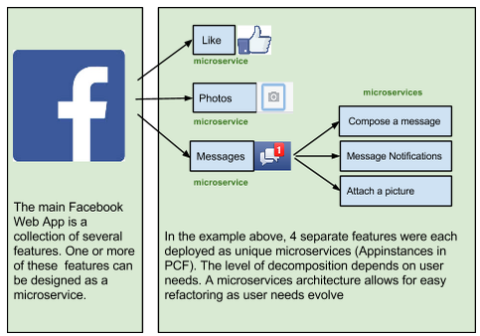
A familiar Microservice example

Slide 18
Challenges of distributed systems
Configuration Management
Service Registration & Discovery
Routing & Load Balancing
Fault Tolerance (Circuit Breakers)
Monitoring
…
Notes:
Everybody faces these, SCS takes PCF to the next level

Slide 19
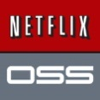
Companies want to be fast like Netflix
Netflix needed to be faster to win / disrupt
Pioneer & vocal proponent of microservices - the key to their speed and success
Netflix OSS supplies parts, but it’s not a solution
Difficult for enterprises to build it themselves
Pivotal offers the closest thing to “Netflix in a box” today
“
“Velocity on the JVM is the Killer App”
- Andy Glover (Netflix Eng) @ SpringOne2GX 2014 Keynote
https://youtu.be/xU267-YHN5c?t=1938
Notes:
NetFlix, an undisputed business & technology leader
34% of peak N. American internet traffic from 6-9pm
If speed was why they won, microservices was how
They pioneered / began to popularize micro service concept
All they had was Amazon EC2 back then
They had to invent a distributed platform, cloud native platform with PaaS – like features
They had to invent microservice infrastructure at the application level
All before writing one line of code that relates to the application you and I know as Netflix
NetflixOSS is a talent acquisition and retention strategy, they are in the movie business 1st, and the software business 2nd.
Open source and supporting their developer’s efforts in the industry is how they are able to attract and retain the best engineers, giving them the ability to invent all this stuff.
That’s tough to duplicate.
Detail on Netflix quote: Netflix needed the performance, stability, concurrency of the JVM, but was searching the right RAD capability to give them the velocity they wanted.

Slide 20
It takes a platform
An end-to-end platform that makes implementing distributed application best practices, a turn-key and first practice
Notes:
Inverse Conway Maneuver coined by Thoughtworks - http://jonnyleroy.com/2011/02/03/dealing-with-creaky-legacy-platforms/
Goal is to create self contained, business aligned teams with the smallest feedback loop.
Business capability teams interact with platform operations team via APIs and not meetings. This creates a friction free experience for the business capability team who now have the tools to

Slide 21


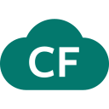
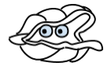
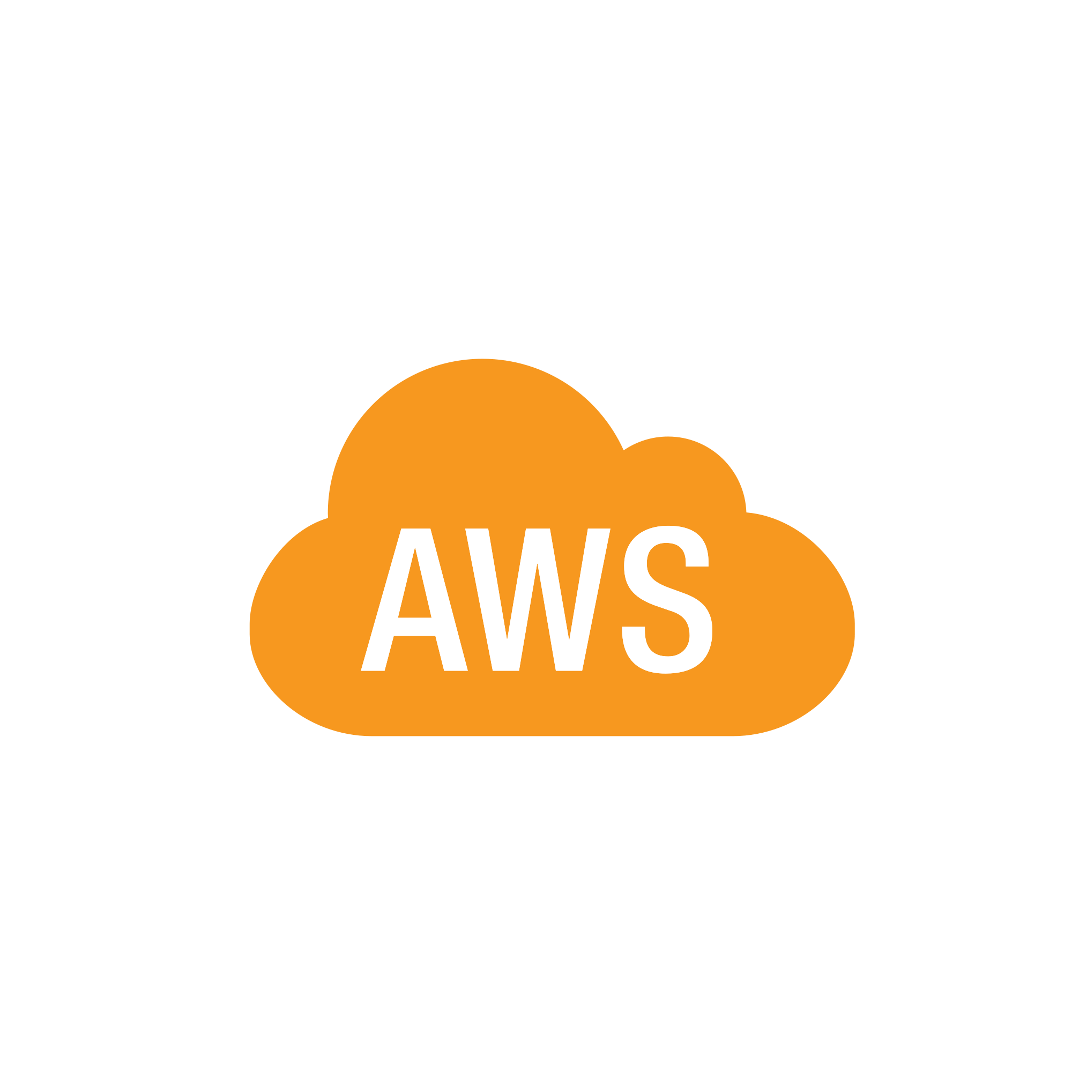
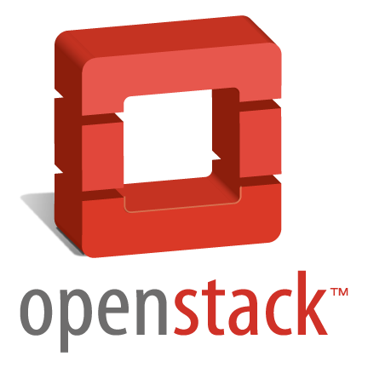
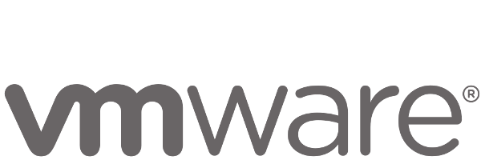
Anatomy of a Cloud Native Platform
1. Application Framework
Developer
Contract – 12 Factor App
2. Container Runtime
Dev+Ops
Contract – BOSH Release
IT Ops
3. Infrastructure Automation
Contract – Cloud Provider Interface
4. Infrastructure
IT Ops
“Contracts” between Applications, opinionated frameworks like Spring Boot and Spring Cloud and opinionated Cloud Native Platforms like Cloud Foundry help significantly accelerate the development of Cloud Native applications
Notes:
That is and should be a governing principle behind any cloud platform, library, or tool. Spring Cloud–an open-source library–makes it easy to develop JVM applications for the cloud. With it, applications can connect to services and discover information about the cloud environment easily in multiple clouds such as Cloud Foundry and Heroku. Further, you can extend it to other cloud platforms and new services.
Application Framework
Spring Cloud : used by Netflix
Spring Boot now over 1M downloads a month, historic levels of growth
Runtime platform
Cloud Foundry elastic runtime used by top FS leaders
Enterprise production ready Linux Container based platform
Infrastructure Automation
CF BOSH: Embedded OS, cloud API integrated
Incredible operational leverage; machine to machine automation

Slide 22
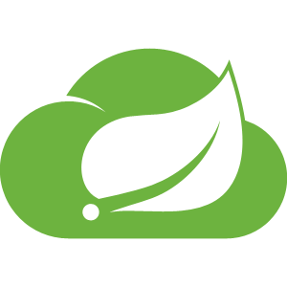


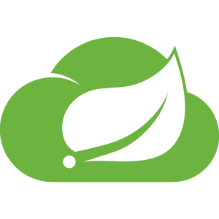

Application Framework
Spring Cloud
Spring Boot
Steel Toe
Dev
Spring Cloud
Spring Boot
Designed for fragile infrastructure in partnership with Netflix
From 0 to app in < 5 min
Steel Toe
Bringing Spring goodness to .Net with Microsoft
Notes:
This month alone, there were over 1.6m downloads, 8m YTD, growing at 10% m/o/m key new projects. Why? because developers love Boot - It’s zero config, super lightweight, runtime ideal for single purpose single process applications aka microservices. With Boot you can go from 0 to app in <5minutes
But remember the concept of fragile infrastructure and designing for failure? How do you wire up all these little processes into a cohesive app that works even when things go wrong?
Luckily Netflix has solved some of these problems at web scale ( their OSS stack is great, but not so easy to use). Swe took that core functionality and built spring cloud. All the power of eureka, hysterix, and config server built as spring modules. As easy adding an annotation and secure for the enteprrise
So awesome even netflix is using it now now we have the app devs able to run super fast and make lots of microservices and tie them together to make amazing apps with spring boot and cloud
But this actually created a huge ops problem …..

Slide 23
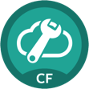
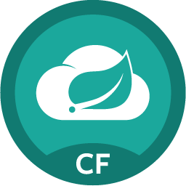


Spring Cloud Services Suite
Git URL for Config Repo provided via Service Dashboard (post-provisioning)
Single tenant, scoped to CF space
Config Server
Service Registration and Discovery via Netflix OSS Eureka
Registration via CF Route
Service Registry
Spring Cloud
Services
Netflix OSS Turbine + Hystrix Dashboard
Aggregation via AMQP (RabbitMQ)
Circuit Breaker Dashboard
Notes:
Config Server
Git URL for Config Repo provided via Service Dashboard (post-provisioning)
Single tenant, scoped to CF space (nothing prevents shared Git repo)
Service Binding via Spring Cloud Connector
Service Registry
Service Binding via Spring Cloud Connector

Slide 24
Auto scaling
Container management
Self service
Container Runtime
Dev
IT Ops
Cloud Foundry
Self healing
Integrated logging
Application Performance Management
Notes:
So Spring Boot/Cloud meant create apps fast – But Dev & Ops is asking Day2 questions -
How do you do logging, routing, apm, scaling, and lifecycle management of all these apps.
Enter CF Runtime
best in class container management
integrated agentless logging
with APM
auto scaling
Effortless runtime with minimum human operational overhead. We run 1000s of apps and 10,000s containers on PWS with 6 guys.
But we realized that stopping there wasn't enough

Slide 25
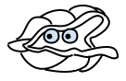
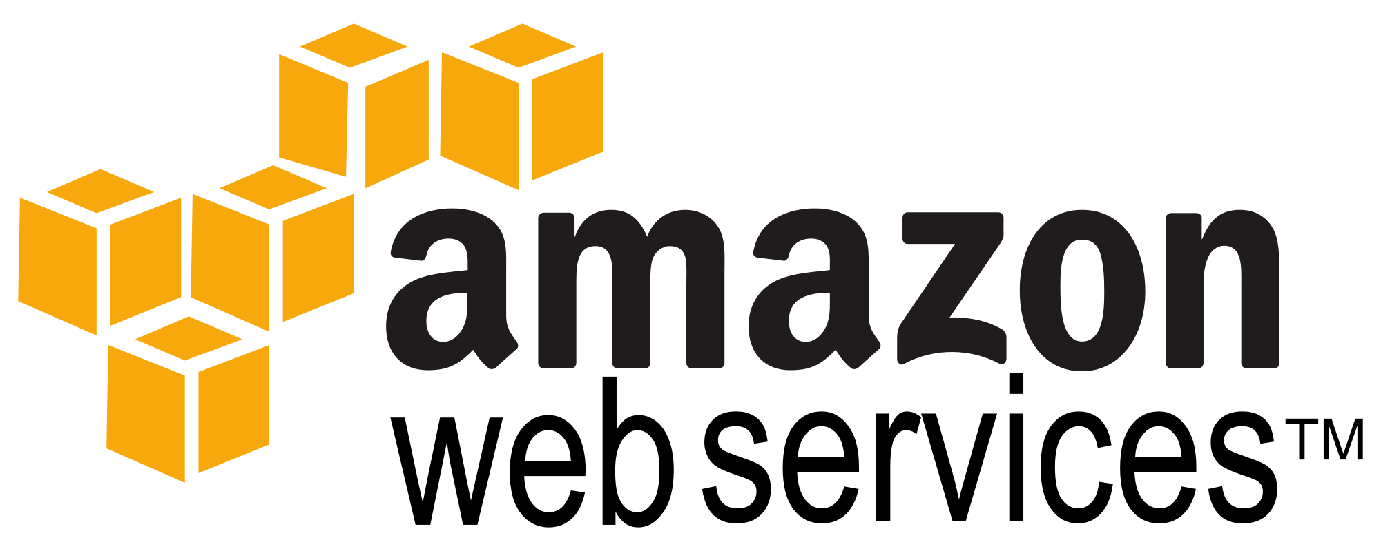
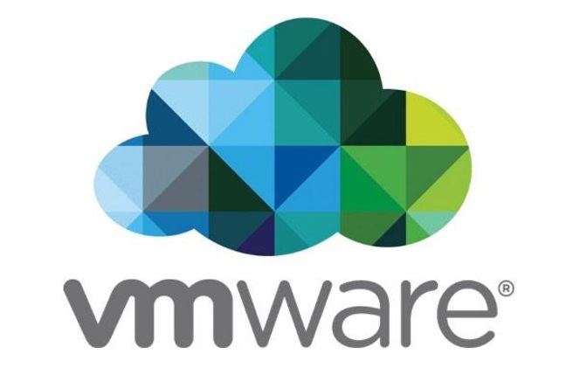

manage services not servers
no maintenance windows
embedded OS
zero downtime
infra as code
multi cloud support
Infrastructure Automation
IT Ops
BOSH
Infrastructure
IT Ops
AWS
VMWare
OpenStack
Notes:
We needed to orchestrate the infrastructure to support this runtime. CF tells the infrastructure what to do and has a common API to support various infra types – AWS, vSphere, Openstack, Azure
When things break (and they will), the notion of self healing kicks in. There is no calling IT Ops, opening tickets, adding new VM’s, creating VM templates, upgrading Operations system, all that is automated and CF takes care of that.
And that gives you - Zero downtime, No maintenance windows
No managing OS upgrades, No managing VM’s
An amazing Operations savings story. What can you do with that time and labor savings ?

Slide 26
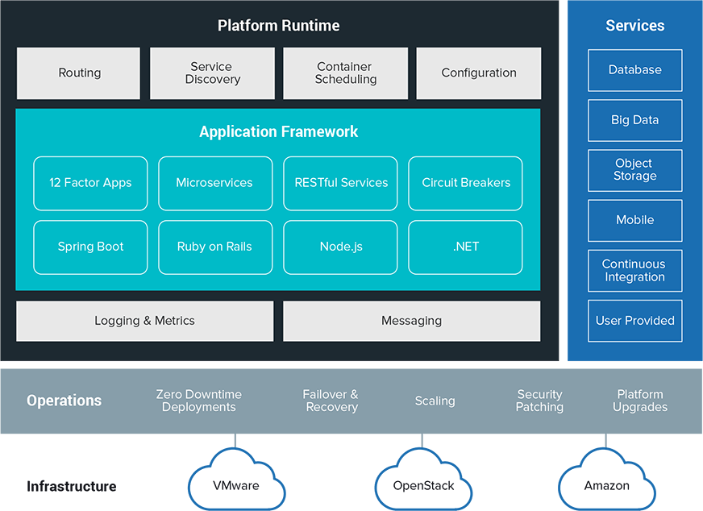
It Takes a Platform
Infrastructure

Slide 27
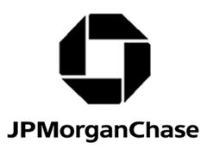
Cloud Native
Maturity Model
Cloud Native
Microservices architecture
API-first design
Fault-tolerant and resilient design
Cloud-agnostic runtime implementation
Bundled metrics and monitoring
Proactive failure testing
Cloud Resilient
Cloud Friendly
12 Factor App methodology
Horizontally scalable
Leverages platform for high availability
Cloud Ready
No permanent disk access
Self-contained application
Platform-managed ports and networking
Consumes platform-managed backing services
Notes:
One of our customers in the finance space, JPMC, has developed a cloud-native maturity model that helps to categorize the movement from monolith to microservices. You have a path both for greenfield apps, and migration or modernization of existing applications to make them cloud-ready.

Slide 28
What’s CLOUD NATIVE for you?
Agile
Lean
Continuous
Delivery
Microservices
Cloud
DevOps

Slide 29
Don’t Play “Cloud Technology Bingo”
Cloud adoption with non-cloud native applications, unopinionated tools and adhoc automation
Spring Boot
Mesos
Puppet
SALT
Kubernetes
Chef
Dropwizard
Amazon Web Services
Docker
Seneca
Chronos
Ansible
Ruby on Rails
VMware vSphere
Azure
OpenStack
Application Frameworks
Container Schedulers
Automation
Tools
Cloud
Infrastructure
Notes:
How are many enterprise moving to an cloud native application designs? Technology bingo with different tools. A cloud and automation tools a-la-carte today, using a combination of individual cloud services or technologies: Just EC2 + services. Just Docker. Docker with Puppet/Chef/Ansible/SALT. MesosSphere or Kubernetes with Docker on EC2. etc etc.
Ad hoc tools are particularly difficult to update, the “Day 2” operation side. When you invest by combining all range of open source projects together,, you end up spending a huge amount of time working on integration. If you’ve got a dozen different open source projects in production, you’ll have to curate thousands of pull requests a wee,, into a secure package. This is an ongoing effort

Slide 31
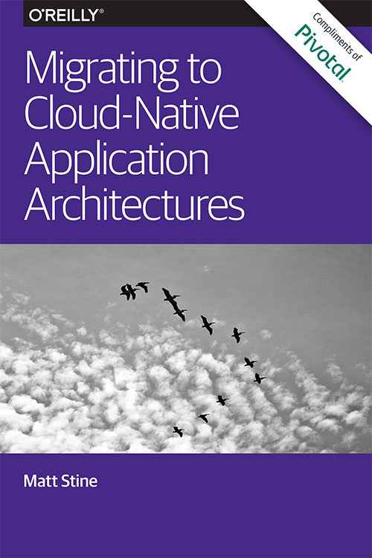
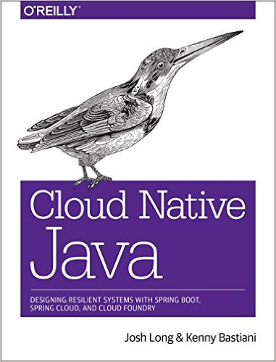
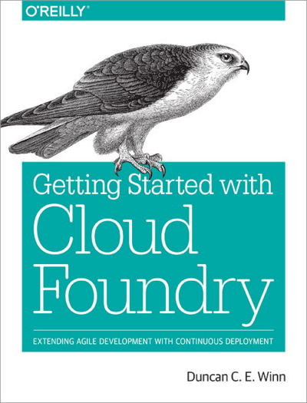
Read
By Matt Stine (@mstine)
By Josh Long (@starbuxman)
and Kenny Bastani
By Duncan Winn (@duncwinn)

Slide 32
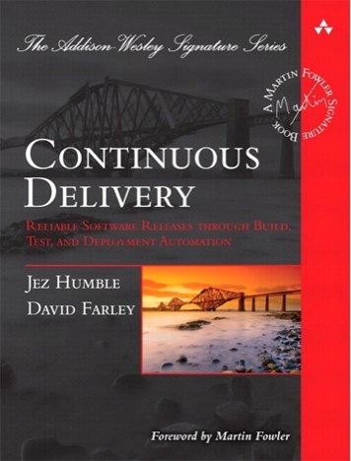
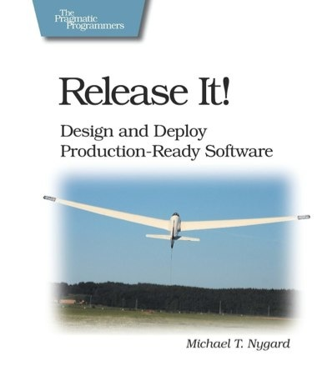
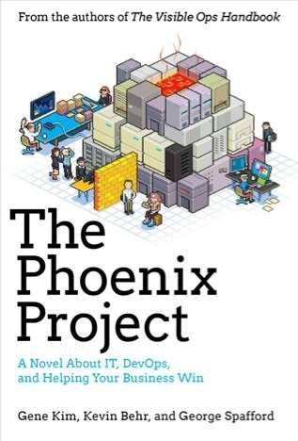
Foundations
Notes:
continuous integration of development changes
one package / many deploys
automation
deploy smaller batches more frequently
automate all testing where test failures would prevent prod release

Slide 33
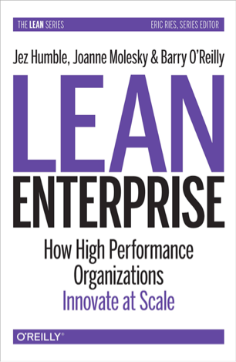
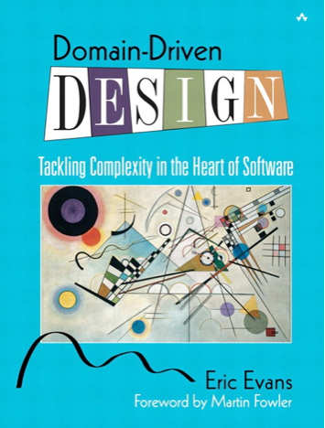
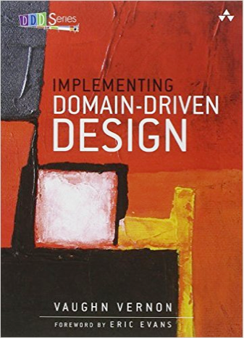
Foundations
Notes:
continuous integration of development changes
one package / many deploys
automation
deploy smaller batches more frequently
automate all testing where test failures would prevent prod release

